Slide 1

E-commerce Product Analysis
Harithaa Kannan

Slide 2
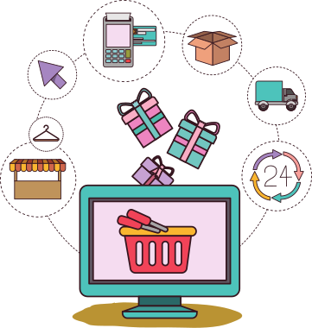
Problem Statement
With the rise of online shopping in India, it's become crucial to analyze product information in detail. This will benefit both businesses and consumers.
This project will dive deep into product data from a leading Indian e-commerce platform to achieve the following goals:
Gain insights into the Indian e-commerce landscape.
Inform strategic decisions and optimizations for businesses and consumers.
Identify popular product categories and brands.
Analyze pricing trends and discount strategies.
Understand seller behavior and performance.
Investigate customer preferences and product satisfaction.
Explore correlations between product attributes (price, rating, brand).
Uncover hidden trends and patterns in product descriptions (Optional).
Ecommerce Presentation

Slide 3
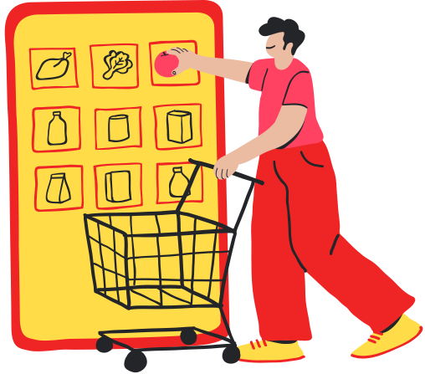
About the Dataset
Title: Product name on the platform.
Id: Internal product identifier.
Price: Base price (without discounts).
Rating: Average customer rating.
Brand: Manufacturer or brand associated with the product.
Category: Broad product classification for browsing.
Crawled Date: Date/time product info was collected.
Description: Product details, features, and specifications.
Discount (Optional): Percentage discount offered.
Images: URLs for product images from different angles.
Stock: In stock (true) or Out of stock (false).
PID (Optional): Unique internal product identifier.
Details: Additional product specifications beyond title/description.
Seller: Name of the product seller on the platform.
Selling Price: Current product price considering discounts.
Sub-Category: More specific product classification within a category.
URL: Link to the product page for viewing or purchase.

Slide 4




Tools Used
To achieve the goals mentioned the tools used are
Excel
PowerBI
Python
PowerPoint
Ecommerce Presentation

Slide 5
The Process
Data Cleaning
Data in Json format
Not clean
0 in important fields
Blank fields
Understanding Data
Column names and what they mean
Role of each columns
Finding Insights and Visualization
Relationship across data
How to present the findings

Slide 6
Findings
Cotton Blend
Cotton Tencel Blend
Some intresting factors
MOST USED FABRICS
PolyCotton
Polyester
Cotton Polyester

Slide 7

4384
2573
Expensive Catogries
2495
2370
clothing style that costs more in average
2033
Blazers, Waistcoats and Suits
TrackSuits
Winter Wear
Clocks Club Clothing
Inspire Clothing

Slide 8


Expensive Brands
Brands with higher cost than average
8599
LAR
6163
G
3969
Sherr
3491
Reebok Classi
3171
Lev

Slide 9
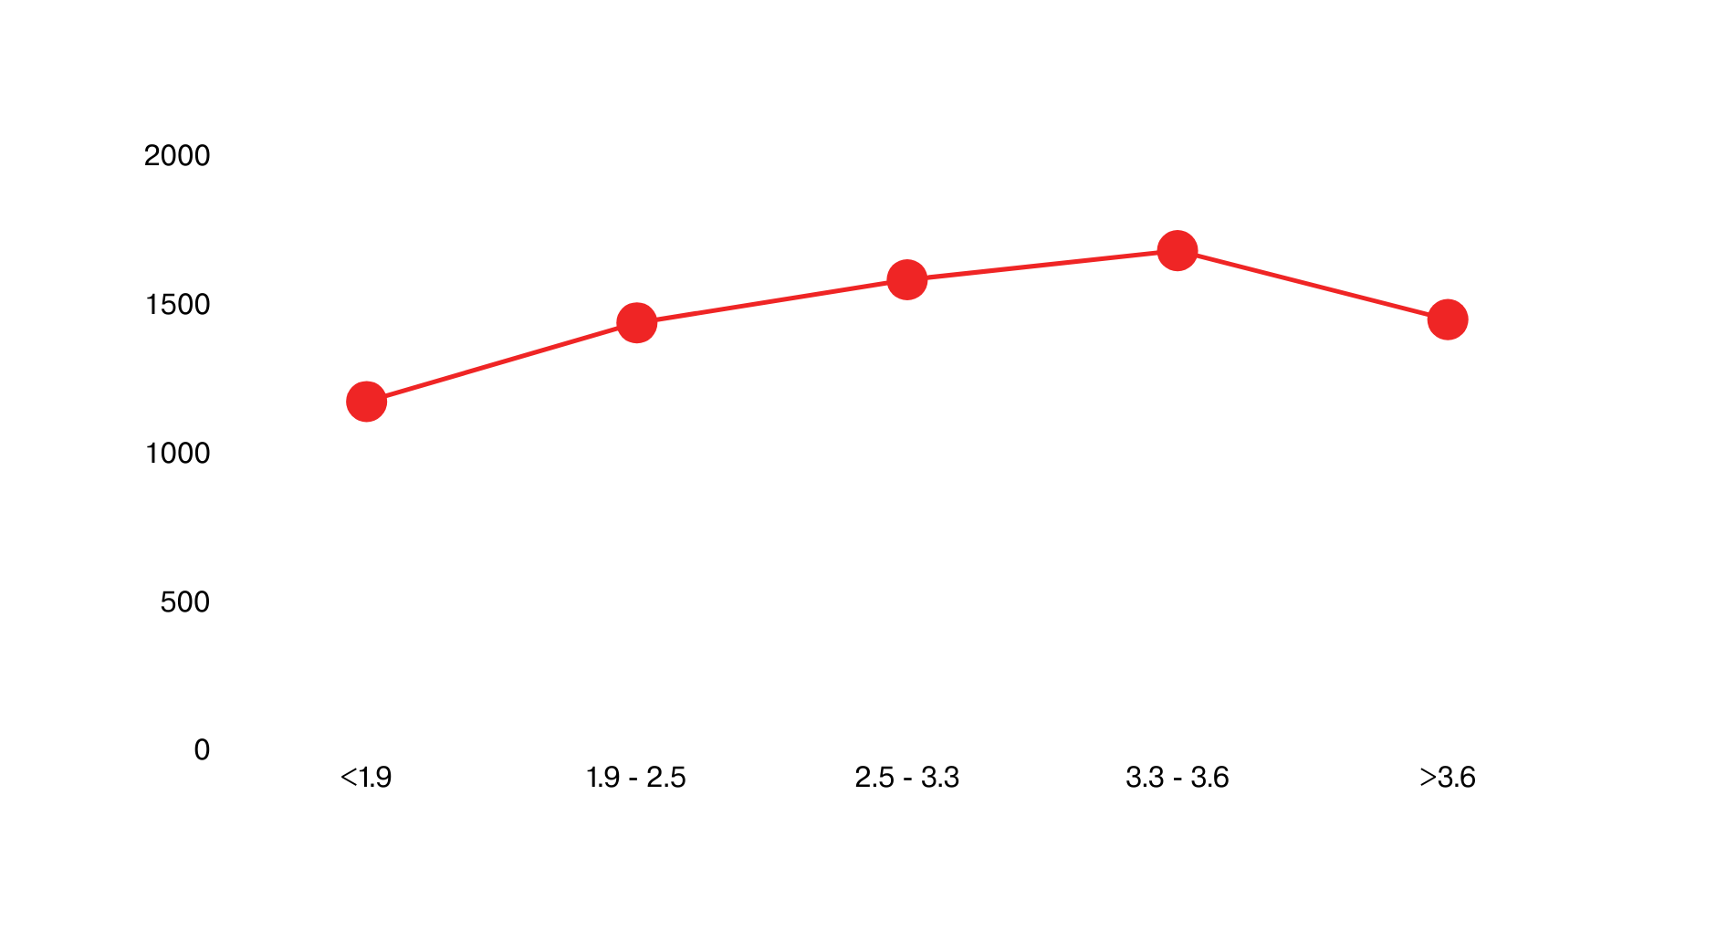
Rating Scale

Slide 10
1
2
3
4
5
8599
4547
Larco Enterprice
Sivaa Textlies
4499
ArvindTrueBlue
3969
3499
Sherrys
Bofrike
Top Expensive Sellers

Slide 11
More Insights
True Bl had the highest Sum of actual_price at 2512736, followed by Pu at 2255030 and REEB at 2169415.
True Bl accounted for 36.22% of Sum of actual_price.
At 4,023.80, ARBO had the highest Rating and was 23.54% higher than Free Authori, which had the lowest Rating at 3,257.20.

Slide 12

THANK YOU!

